Slide 1
Introduction to CSS
Course Code: CSC 3215
Course Title: Web Technologies
Dept. of Computer Science
Faculty of Science and Technology
Lecturer No: | 09 | Week No: | 09 | Semester:
Lecturer: | Sazzad Hossain sazzad@aiub.edu

Slide 2
Lecture Outline
Introduction to CSS
CSS Selectors
CSS Insertion Types
Customizing HTML elements with CSS
CSS Position and Layouts

Slide 3
Introduction to CSS
What is CSS?
CSS stands for Cascading Style Sheets
CSS describes how HTML elements are to be displayed on screen, paper, or in other media
CSS saves a lot of work. It can control the layout of multiple web pages all at once
External stylesheets are stored in CSS files
CSS is used to define styles for your web pages, including the design, layout and variations in display for different devices and screen sizes.

Slide 4
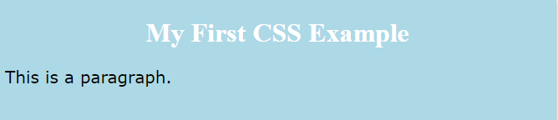
Example
<!DOCTYPE html>
<html>
<head>
<style>
body {
background-color: lightblue;
}
h1 {
color: white;
text-align: center;
}
p {
font-family: verdana;
font-size: 20px;
}
</style>
</head>
<body>
<h1>My First CSS Example</h1>
<p>This is a paragraph.</p>
</body>
</html>
Output:

Slide 5
Explanation
HTML was NEVER intended to contain tags for formatting a web page!
HTML was created to describe the content of a web page, like:
<h1>This is a heading</h1>
<p>This is a paragraph.</p>
Tags like <font>, and color attributes were added to the HTML 3.2 specification.
Development of large websites, where fonts and color information were added to every single page, became a long and expensive process.
CSS removed the style formatting from the HTML page!

Slide 6
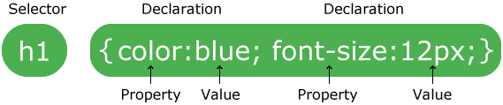
CSS Syntax
selector points to the HTML element you want to style.
The declaration block contains one or more declarations separated by semicolons.
Each declaration includes a CSS property name and a value, separated by a colon.
A CSS declaration always ends with a semicolon, and declaration blocks are surrounded by curly braces.
Can not add a space between the property value and the unit

Slide 7
Example
p { color: red; text-align: center; }
Explanation
p is a selector in CSS.
color is a property, and red is the property value
text-align is a property, and center is the property value

Slide 8
CSS Selectors
CSS selectors divided into five categories:
Simple selectors (select elements based on name, id, class)
Combinator selectors (select elements based on a specific relationship between them)
Pseudo-class selectors (select elements based on a certain state)
Pseudo-elements selectors (select and style a part of an element)
Attribute selectors (select elements based on an attribute or attribute value)

Slide 9
The CSS element Selector
The element selector selects HTML elements based on the element name.
p { text-align: center; color: red; }
h5 { text-align: center; color: red; }

Slide 10
The CSS id Selector
The id selector uses the id attribute of an HTML element to select a specific element.
The id of an element is unique within a page
To select an element with a specific id with a hash (#) character, followed by the id of the element.
An id name cannot start with a number
Example
#para1 {
text-align: center;
color: red;
}
h1 {
color: white;
text-align: center;
}
The CSS rule below will be applied to the HTML element with id="para1":
<h1 id="para1" > hellow </h1>

Slide 11
The CSS class Selector
The class selector selects HTML elements with a specific class attribute.
To select elements with a specific class need to use (.) character, followed by the class name.
In this example all HTML elements with class="center" will be red and center-aligned:
.center { text-align: center; color: red; }
It can be specified only specific HTML elements
should be affected by a class.
In this example only <p> elements with class="center" will be center-aligned:
p.center { text-align: left; color: white; }
<p class=“center”>
Hello world
</p>
<h1 class=“center”>
Hello world
</h1>
<p> hellow world 2 </p>

Slide 12
The CSS Universal Selector
The universal selector (*) selects all HTML elements on the page.
Example
The CSS rule below will affect every HTML element on the page:
* { text-align: center; color: blue; }

Slide 13
The CSS Grouping Selector
The grouping selector selects all the HTML elements with the same style definitions.
It will be better to group the selectors to minimize the code.
To group selectors, separate each selector with a comma.
Example
In this example we have grouped the selectors from the code above:
h1, h2, p { text-align: center; color: red; }

Slide 14
Inserting CSS
There are three ways of inserting a style sheet:
External CSS
Internal CSS
Inline CSS

Slide 15
External CSS
External style sheet is an external file which can be imported to the HTML file.
HTML page must include a reference to the external style sheet file inside the <link> element, inside the head section.
External styles are defined within the <link> element, inside the <head> section of an HTML page.
Example
<!DOCTYPE html>
<html>
<head>
<link rel="stylesheet" type="text/css" href="mystyle.css">
</head>
<body>
<h1>This is a heading</h1>
<p>This is a paragraph.</p>
</body>
</html>

Slide 16
External CSS
An external style sheet can be written with a .css extension.
The external .css file should not contain any HTML tags.
"mystyle.css“
body { background-color: lightblue; } h1 { color: navy; margin-left: 20px;
}

Slide 17
Internal CSS
An internal style sheet may be used if one single HTML page has a unique style.
The internal style is defined inside the <style> element, inside the head section.
Example
<!DOCTYPE html> <html> <head> <style> body { background-color: linen; } h1 { color: maroon; margin-left: 40px; } </style> </head> <body> <h1>This is a heading</h1> <p>This is a paragraph.</p> </body> </html>

Slide 18
Inline CSS
used to apply a unique style for a single element.
To use inline styles, must use style attribute to the relevant element
The style attribute contains <!DOCTYPE html>
<html> <body> <h1 style="color:blue;text-align:center;">This is a heading</h1> <p style="color:red;">This is a paragraph.</p> </body> </html>

Slide 19
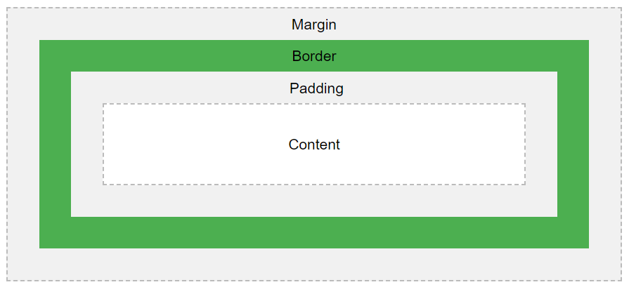
CSS Box Model
The CSS box model is essentially a box that wraps around every HTML element.
It consists of: margins, borders, padding, and the actual content.

Slide 20

CSS Box Model
Content - The content of the box, where text and images appear
Padding - Clears an area around the content. The padding is transparent
Border - A border that goes around the padding and content
Margin - Clears an area outside the border. The margin is transparent
div {
width: 320px;
padding: 10px;
border: 5px solid gray;
margin: 0;
}
The <div> tag defines a division or a section in an HTML document.
The <div> element is often used as a container for other HTML elements to style them with CSS or to perform certain tasks with JavaScript.

Slide 21
CSS Box Model
The total width of an element should be calculated :
320px (width) + 20px (left + right padding) + 10px (left + right border) + 0px (left + right margin) = 350px
Total element width = width + left padding + right padding + left border + right border + left margin + right margin
Total element height = height + top padding + bottom padding + top border + bottom border + top margin + bottom margin

Slide 22
CSS Layout and Position
The position property specifies the type of positioning method used for an element.
There are five different position values:
static
relative
fixed
absolute
Sticky
Elements are then positioned using the top, bottom, left, and right properties. However, these properties will not work unless the position property is set first. They also work differently depending on the position value.

Slide 23
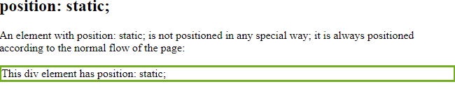
position: static;
HTML elements are positioned static by default.
Static positioned elements are not affected by the top, bottom, left, and right properties.
An element with position: static; is not positioned in any special way;
it is always positioned according to the normal flow of the page:
This <div> element has position: static;
Here is the CSS that is used:
Example
div.static {
position: static;
border: 3px solid #73AD21;
}

Slide 24
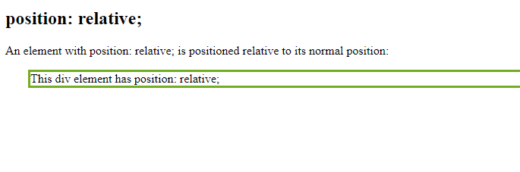
position: relative;
An element with position: relative; is positioned relative to its normal position.
Setting the top, right, bottom, and left properties of a relatively-positioned element will cause it to be adjusted away from its normal position.
Other content will not be adjusted to fit into any gap left by the element.
This <div> element has position: relative;
Here is the CSS that is used:
Example
div.relative {
position: relative;
left: 30px;
border: 3px solid #73AD21;
}

Slide 25
position: fixed;
An element with position: fixed; is positioned relative to the viewport
it always stays in the same place even if the page is scrolled.
The top, right, bottom, and left properties are used to position the element.
A fixed element does not leave a gap in the page where it would normally have been located.
div.fixed {
position: fixed;
bottom: 0;
right: 0;
width: 300px;
border: 3px solid #73AD21;
}

Slide 26
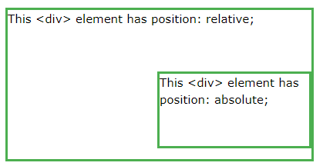
position: absolute;
absolute is positioned relative to the nearest positioned ancestor.
an absolute positioned element has no positioned ancestors, it uses the document body, and moves along with page scrolling.
"positioned" element is one whose position is anything except static.
div.relative {
position: relative;
width: 400px;
height: 200px;
border: 3px solid #73AD21;
}
div.absolute {
position: absolute;
top: 80px;
right: 0;
width: 200px;
height: 100px;
border: 3px solid #73AD21;
}

Slide 27
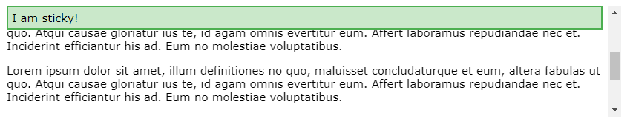
position: sticky;
sticky is positioned based on the user's scroll position.
A sticky element toggles between relative and fixed, depending on the scroll position. It is positioned relative until a given offset position is met in the viewport - then it "sticks" in place.
div.sticky { position: sticky; top: 0; background-color: green; border: 2px solid #4CAF50; }

Slide 28
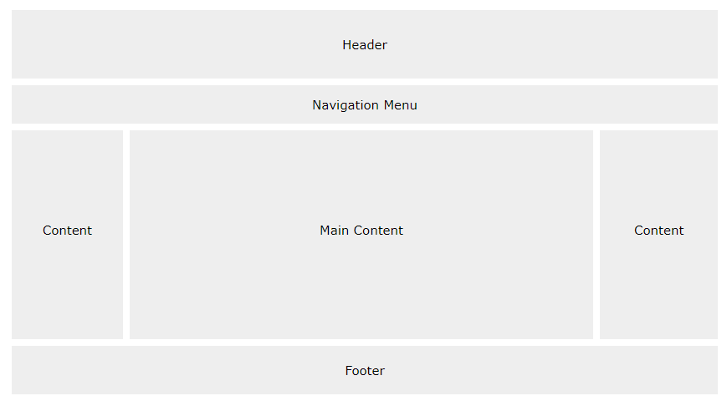
Website Layout
A website is often divided into headers, menus, content and a footer:

Slide 29
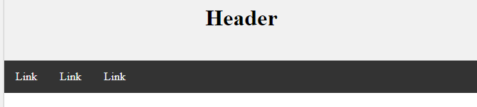
Header And Navigation Bar
A header is usually located at the top of the website
It often contains a logo or the website name.
A navigation bar contains a list of links
.header { background-color: #F1F1F1; text-align: center; padding: 20px; } .topnav { overflow: hidden; background-color: #333; } .topnav a { float: left; display: block; color: #f2f2f2; text-align: center; padding: 14px 16px; text-decoration: none; } .topnav a:hover { background-color: #ddd; color: black; }
<body>
<div class="header">
<h1>Header</h1>
</div>
<div class="topnav">
<a href="#">Link</a>
<a href="#">Link</a>
<a href="#">Link</a>
</div>
</body>

Slide 30
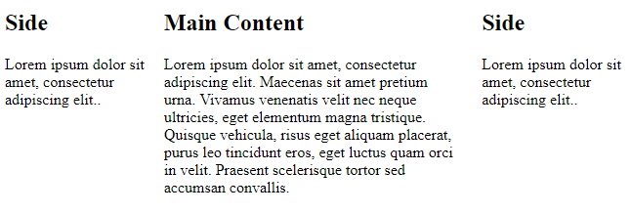
Main Body with Columns
The main content is the biggest and the most important part of site.
The side content is often used as an alternative navigation or to specify information relevant to the main content.
Widths can be changed and that it should add up to 100% in total.
.column {
float: left;
padding: 10px;
}
/* Left and right column */
.column.side {
width: 25%;
}
/* Middle column */
.column.middle {
width: 50%;
}

Slide 31
Footer
The footer is placed at the bottom of page.
It often contains information like copyright and contact info.
.footer { background-color: #F1F1F1; text-align: center; padding: 10px; }

Slide 32
References
MySQL - www.mysql.com
W3Schools Online Web Tutorials- www.w3schools.com
PHP Manual - www.php.net

Slide 33
Books
Sams Teach Yourself Ajax JavaScript and PHP All in One; Phil Ballard and Michael Moncur;
Sams Publishing; 2010
JavaScript Phrasebook; Christian Wenz; Sams Publishing; 2007
PHP and MySQL Web Development, 4/E; Luke Welling and Laura Thomson; AddisonWesley Professional; 2009
JavaScript for Programmers Paul J. Deitel and Harvey M. Deitel; Prentice Hall; 2009

